Slide 1
Dan’s Certification Journey
Dan P. CISSP CISM, Solution Architect
https://github.com/dan-pi/

Slide 2
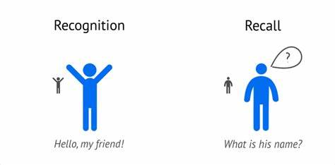
Hello, my friends!

Slide 3

“I know kung fu”

Slide 4
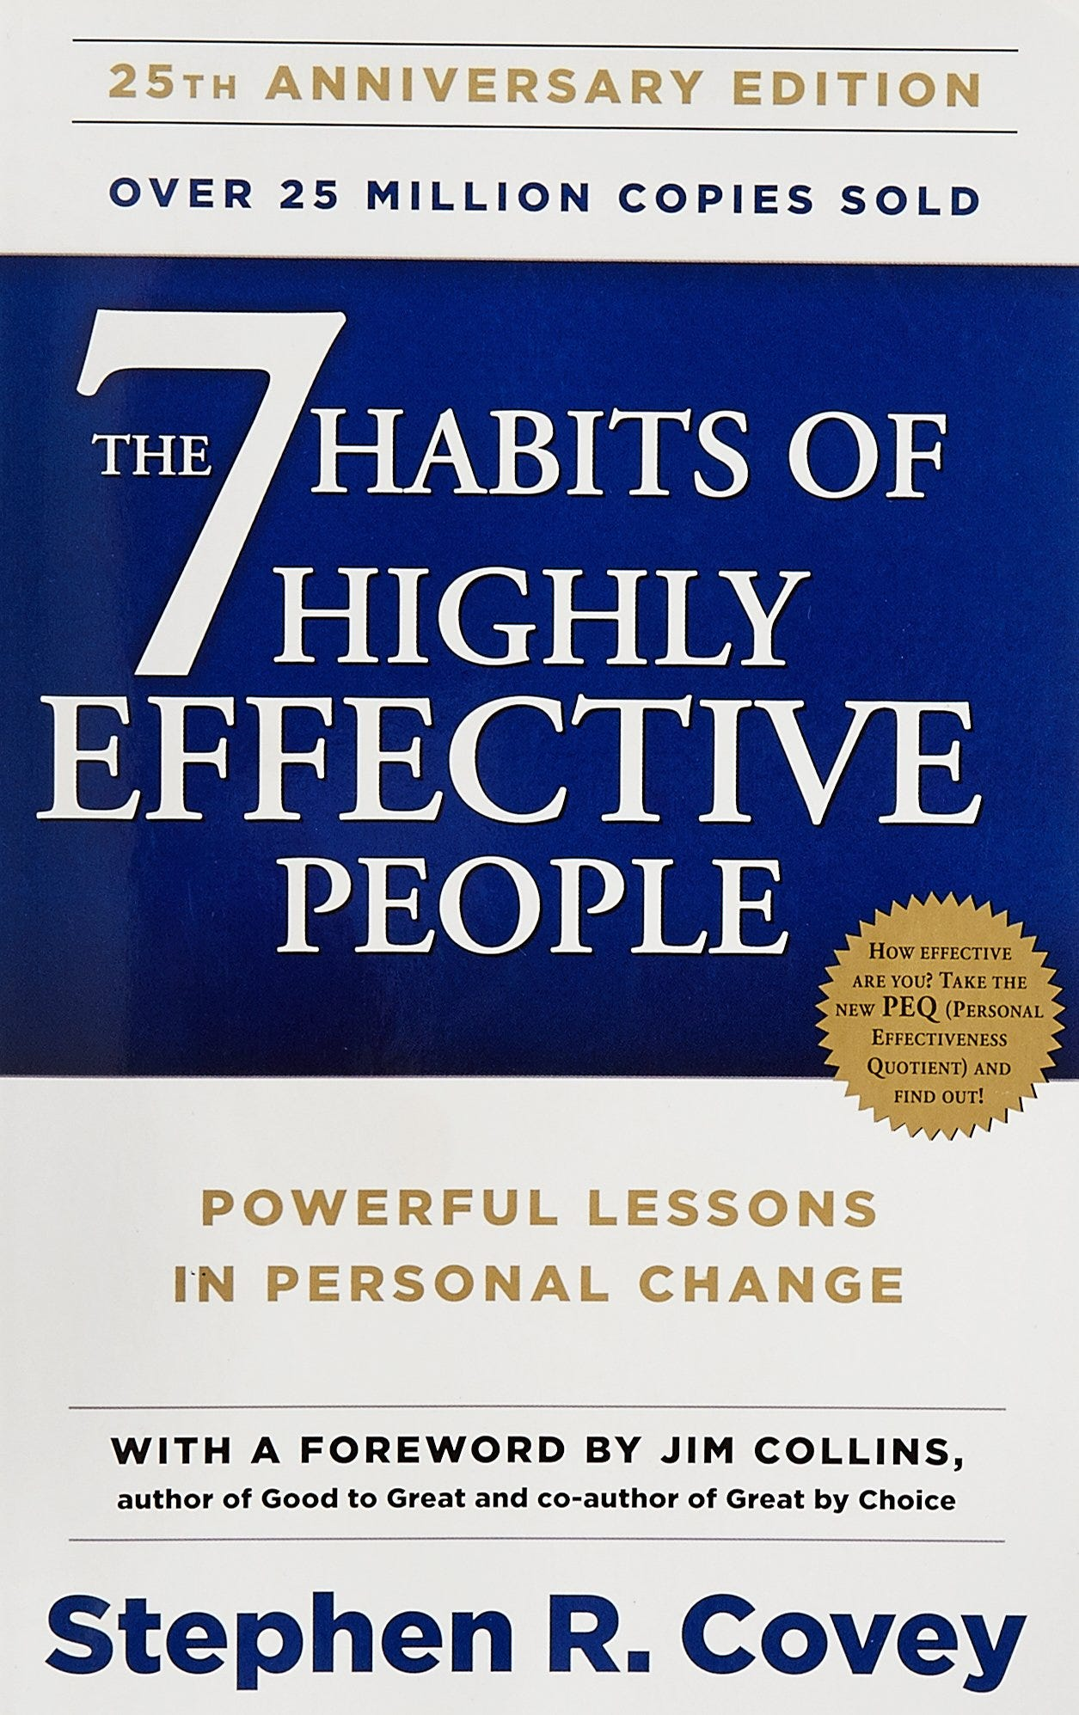
My friend Ali suggested I read this book!

Slide 5
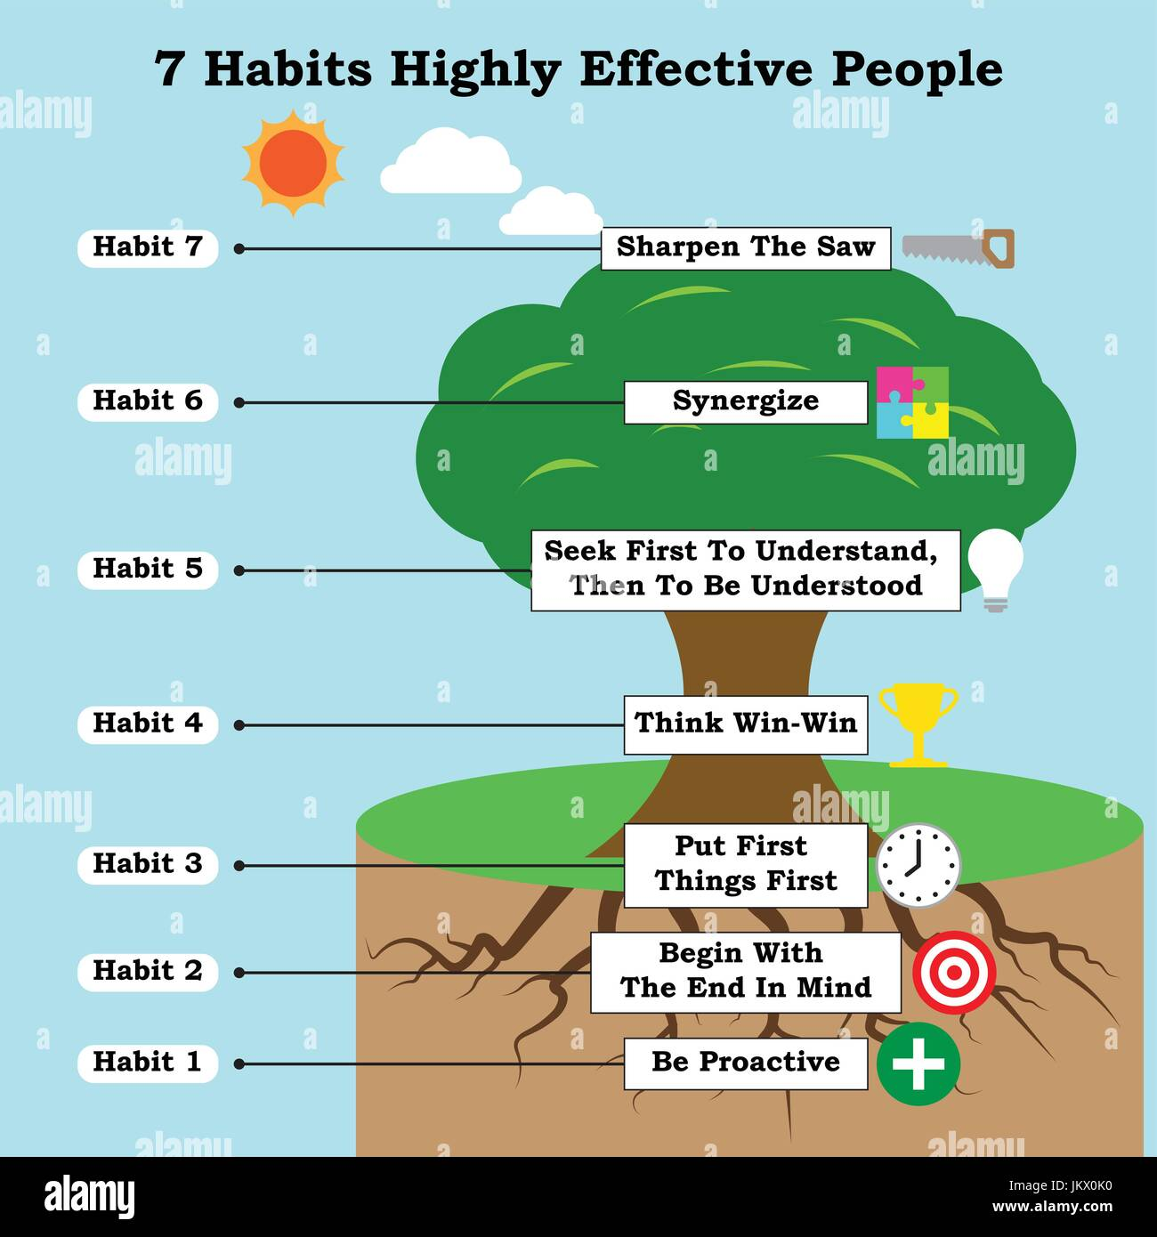

Slide 6
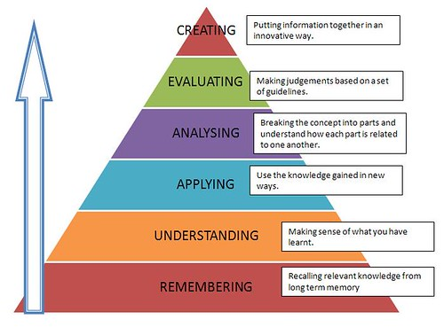
Bloom’s Taxonomy

Slide 7
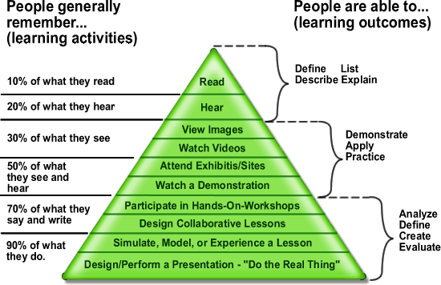
Learning Pyramid

Slide 8
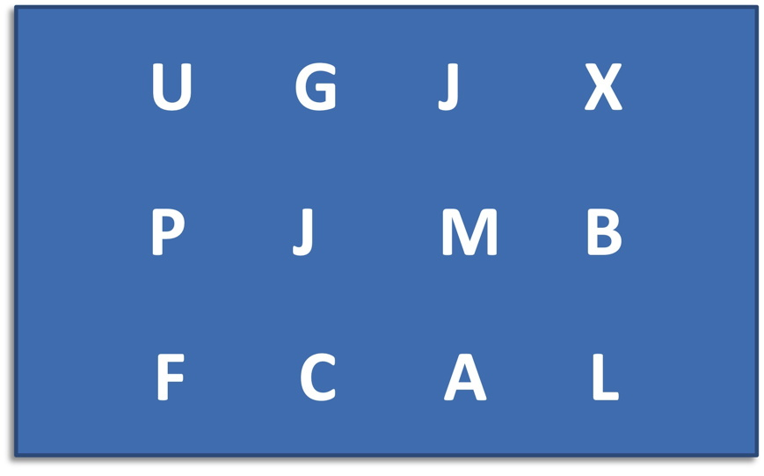

Slide 9
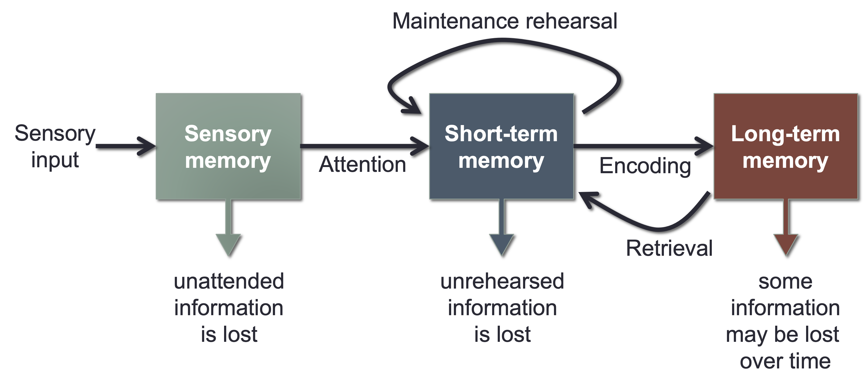
Introduction to Memory and Cognition –Open Educational Resources - PSYC341
https://bobsthinktank.github.io/PSYC341OER/

Slide 10
Sensory memory
Sensory memory preserves information in its original sensory form for a brief time, usually only a fraction of a second
Example: the afterimage created when you move a sparkler very quickly
Some researchers argue that sensory memory is more of an “echo” than a “memory”
Auditory sensory memory (echoic) lasts 2-4 seconds
Visual sensory memory (iconic) lasts approximately ¼ second
George Sperling (1960) experiment on visual sensory store
PSY 1000 - Introduction to Psychology (Zeigler-Hill)

Slide 11
Encoding: Getting Information Into Memory
In general, you need to pay attention to information if you intend to remember it.
Attention involves focusing awareness on a narrowed range of stimuli or events
Selective attention is critical to everyday functioning
Just imagine how poorly you would function if everything in your environment demanded equal attention
Attention acts like a filter that screens out most stimuli
Cocktail party phenomenon
Divided attention impairs performance
PSY 1000 - Introduction to Psychology (Zeigler-Hill)

Slide 12
Short-term memory
Short-term memory is a limited capacity store that can maintain unrehearsed information for up to about 20 seconds
Selective attention is important for moving information from sensory memory to short-term memory
Limited capacity: magical number 7 plus or minus 2
Chunking: grouping related stimuli for storage as a single unit
Limited duration: about 10-20 seconds without rehearsal
Rehearsal: the process of repetitively verbalizing or thinking about the information
PSY 1000 - Introduction to Psychology (Zeigler-Hill)

Slide 13
Long-term memory: Unlimited Capacity
Long-term memory is an unlimited capacity store that can hold information over lengthy periods of time
Permanent storage?
Flashbulb memories: unusually vivid and detailed recollections of momentous events
Memory is more malleable and less accurate than generally appreciated
Debate: are short-term memory and long-term memory really different?
Some researchers argue that there may only be one “generic” memory store or that short-term memory is a specialized form of long-term memory occurring in a heightened state of activation
PSY 1000 - Introduction to Psychology (Zeigler-Hill)

Slide 14
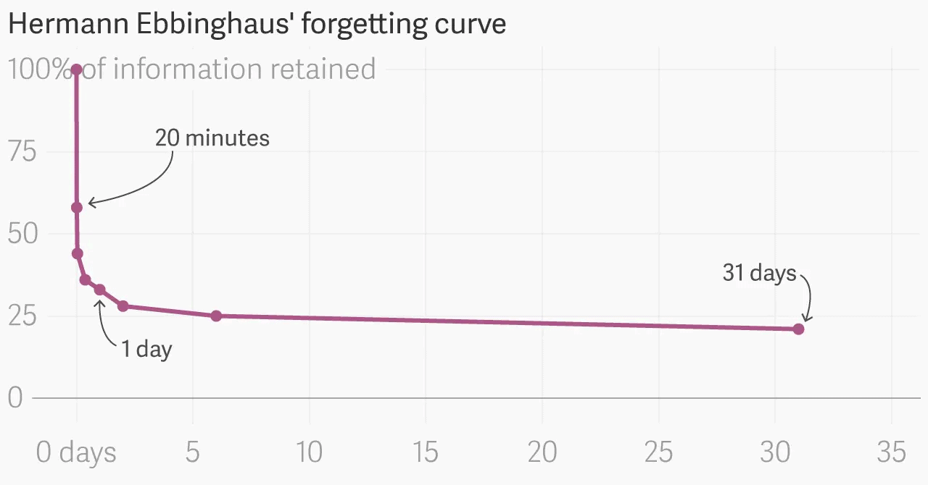
Forgetting Curve

Slide 15
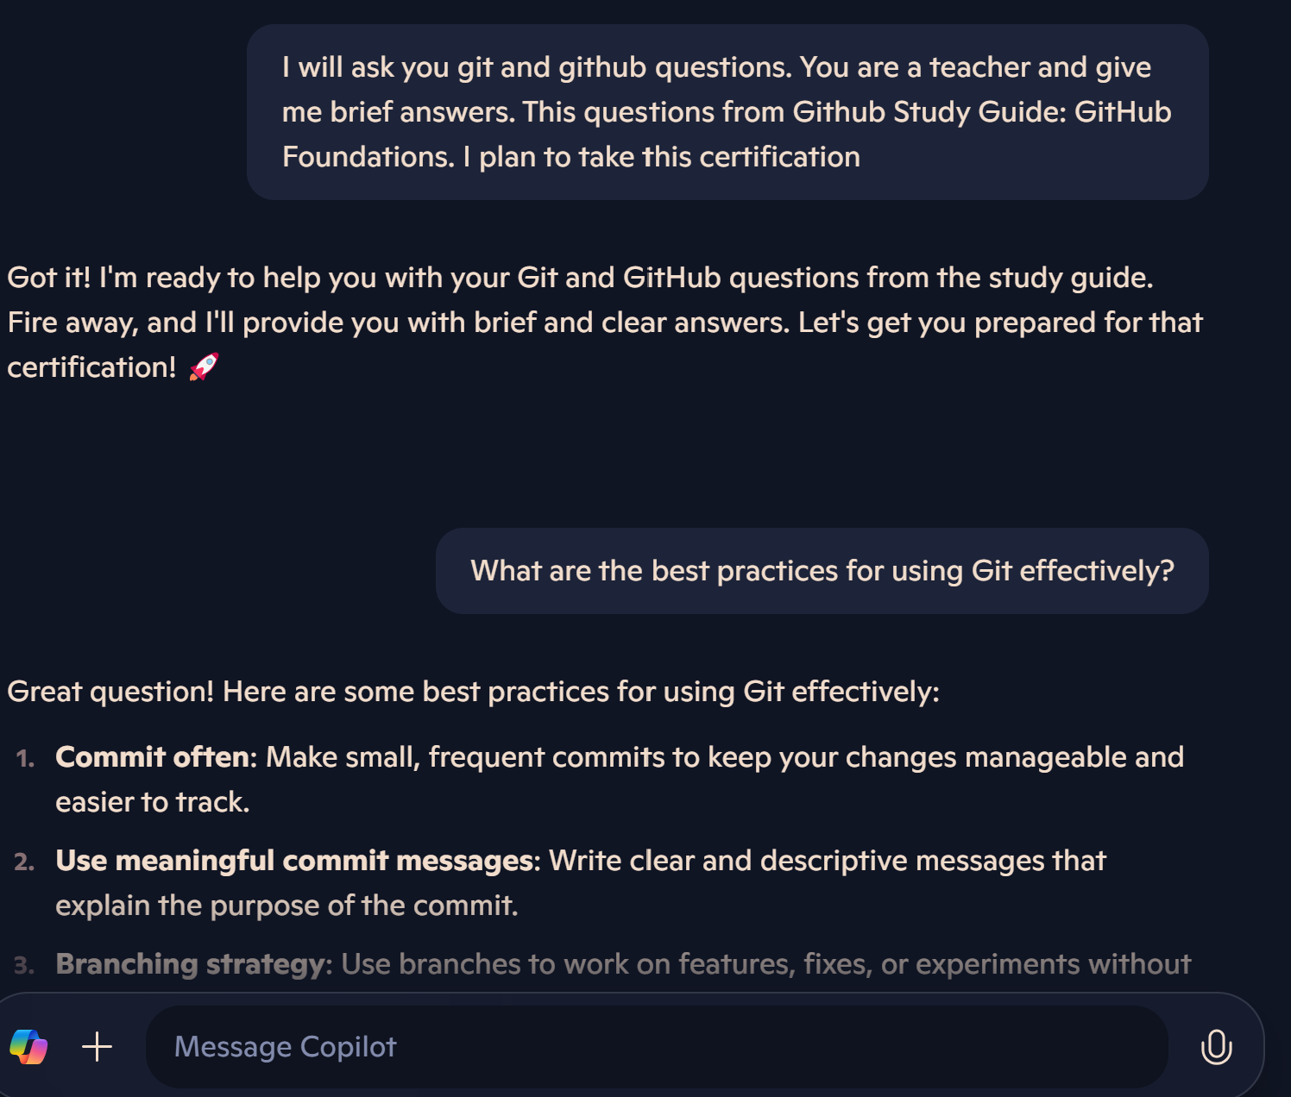

Slide 16
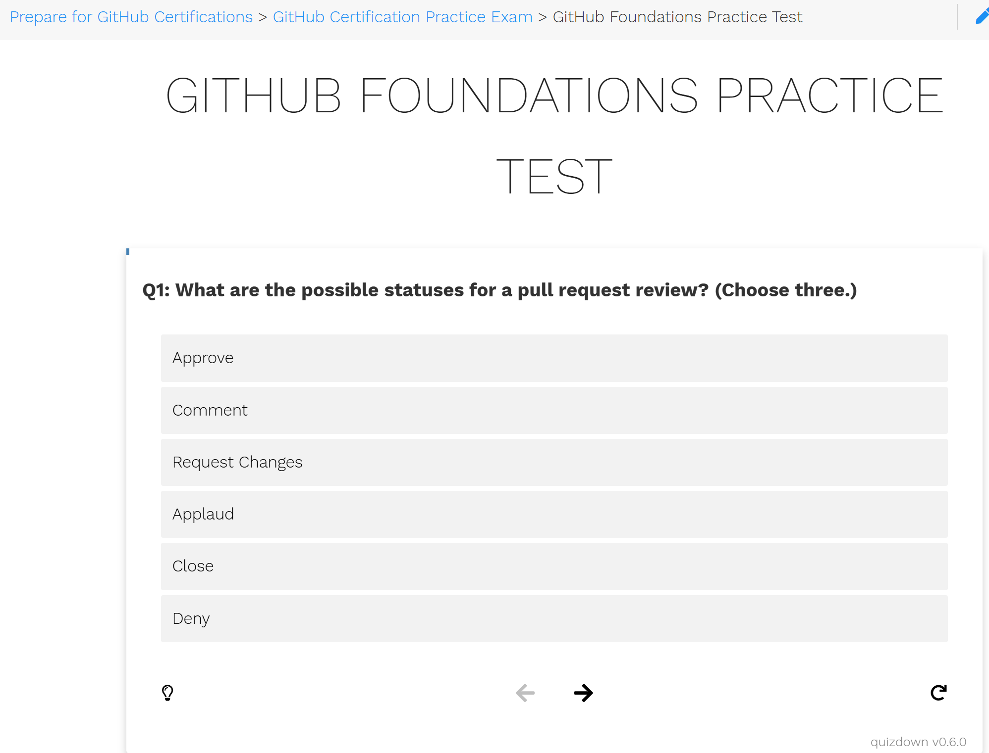
https://ghcertified.com/practice_tests/foundations/

Slide 17
Microsoft / GitHub exam prep resources
Microsoft Learn for GitHub https://learn.microsoft.com/en-us/training/github/ Scroll to bottom, click ‘Register today’ to register (or not, even MS struggle with broken links)
Microsoft’s Exam Readiness Zone https://learn.microsoft.com/en-us/shows/exam-readiness-zone (MCT x GitHub?)
GitHub Education https://education.github.com/experiences/foundations_certificate
https://github.com/LadyKerr/github-certification-guide/blob/main/study-guides/gh-foundations.md
Datacamp (free sign-up)
LinkedIn Learning (good if your employer pays)
GitHub Education (if you have a .edu email address, unlocks bonus content on the GitHub Education site)
3rd party resources e.g.: https://github.com/btkrausen/github_certification
Candidate Handbook (logistics) https://examregistration.github.com/handbook
GitHub Docs https://docs.github.com/en

Slide 18
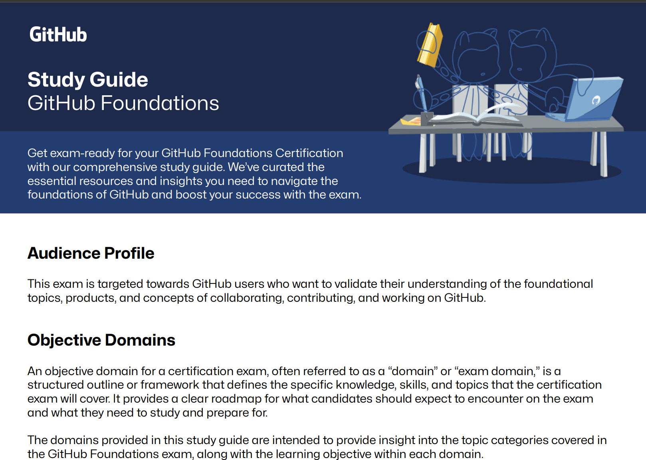
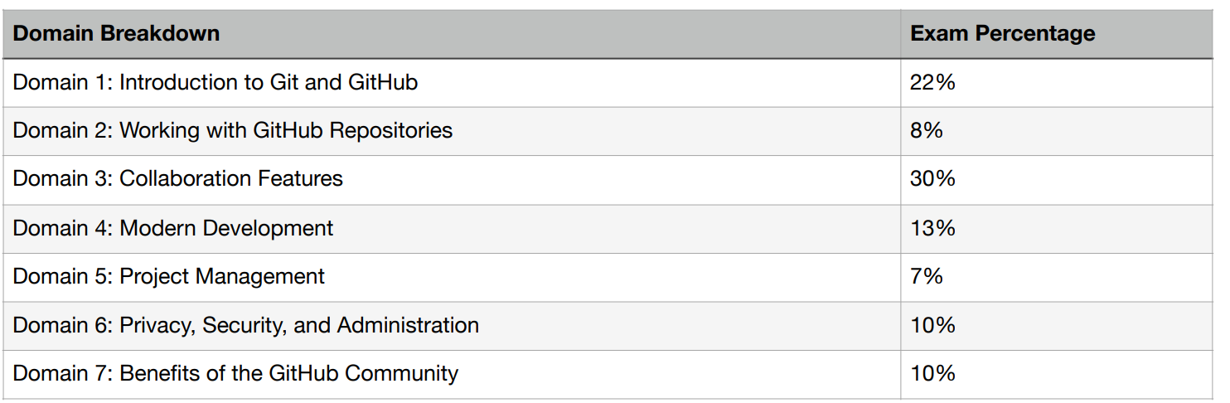
https://github.com/LadyKerr/github-certification-guide/blob/main/study-guides/gh-foundations.md

Slide 19

GitHub Student Developer Pack
https://education.github.com/pack
Free tools like GitHub Pro, JetBrains IDEs, Microsoft Azure credits, and much more.

Slide 20
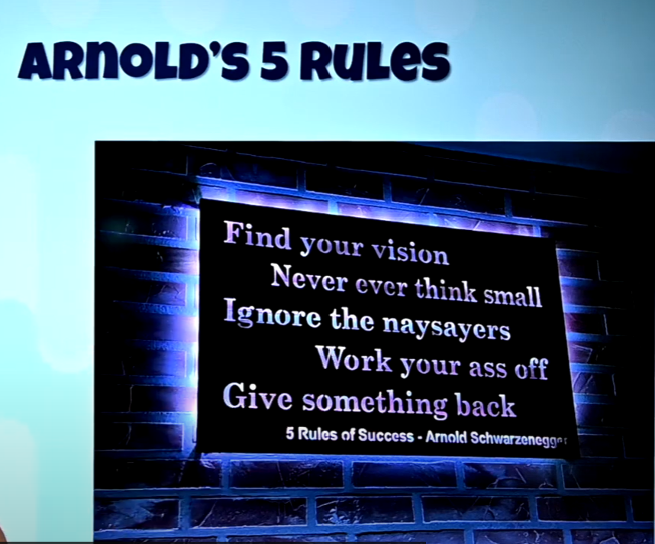
John Savill’s Technical Training
John Savill @ntfaqguy works at Microsoft.
He makes the time outside his day job to freely give back to the community:
DevOps Master Class https://www.youtube.com/watch?v=YMdtaWfU_QE
Azure Master Class v3 https://www.youtube.com/watch?v=afzzawldfFk
Azure Weekly update https://www.youtube.com/watch?v=IYShpL69FJQ
Keynote – Arnold’s 5 rules https://www.youtube.com/watch?v=5KhdPCfddZY

Slide 21

Exam tip [0]

Slide 22
Exam tip [1-2]
Prepare
Complete the Microsoft Learn modules, including the Hands-On Labs.
I recommend John Savill’s Technical Training (YouTube, free)
Practice makes progress. Practice tests are a MUST: https://ghcertified.com/practice_tests/foundations/
Keep calm and carry on
- 120 minutes to answer 75 questions.
- Carefully read through each question. Weigh up all of the options.
- Eliminate wrong answers.
- Choose the best available answer.
- If in doubt, trust your gut / professional experience and give your best guess.
- Answer every question.
- Mark any questions if unsure, you can review later if there is time left at the end.
- Try not to second guess yourself. Only change your answer if confident you misread or misunderstood the question first time round.
- Stay calm and focused — there’s no need to rush.

Slide 23

Gooaaaaal!!!!
After completing the exam, you will receive your results immediately (or not, on beta or advanced exams may get results 12-24 hours delay.)
When you pass, you will be awarded a GitHub Foundations Badge and Certificate issued by Credly. These credentials can be showcased on your resume or LinkedIn profile to highlight your accomplishment.
If you don’t pass first time around (it happens!), check the feedback for areas to review, then take some more practice exams. You will pass the next time!

